Slide 1
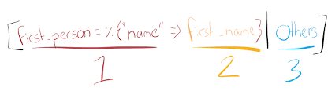

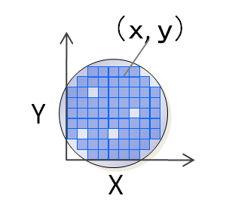

Pattern Matching From Silicon to Software
soundararajan

Slide 2


Agenda
Introduction 4
About you all
About me
Philosophy of Pattern matching 5
Silicon 15
Pattern matching in Silicon wafer inspection
Software 15
Pattern matching in Healthcare Information Technologies
Pattern Matching in Practice 60
Stanford NLP library
Google Cloud
Q & A 15
Buffer / Break 11

Slide 3


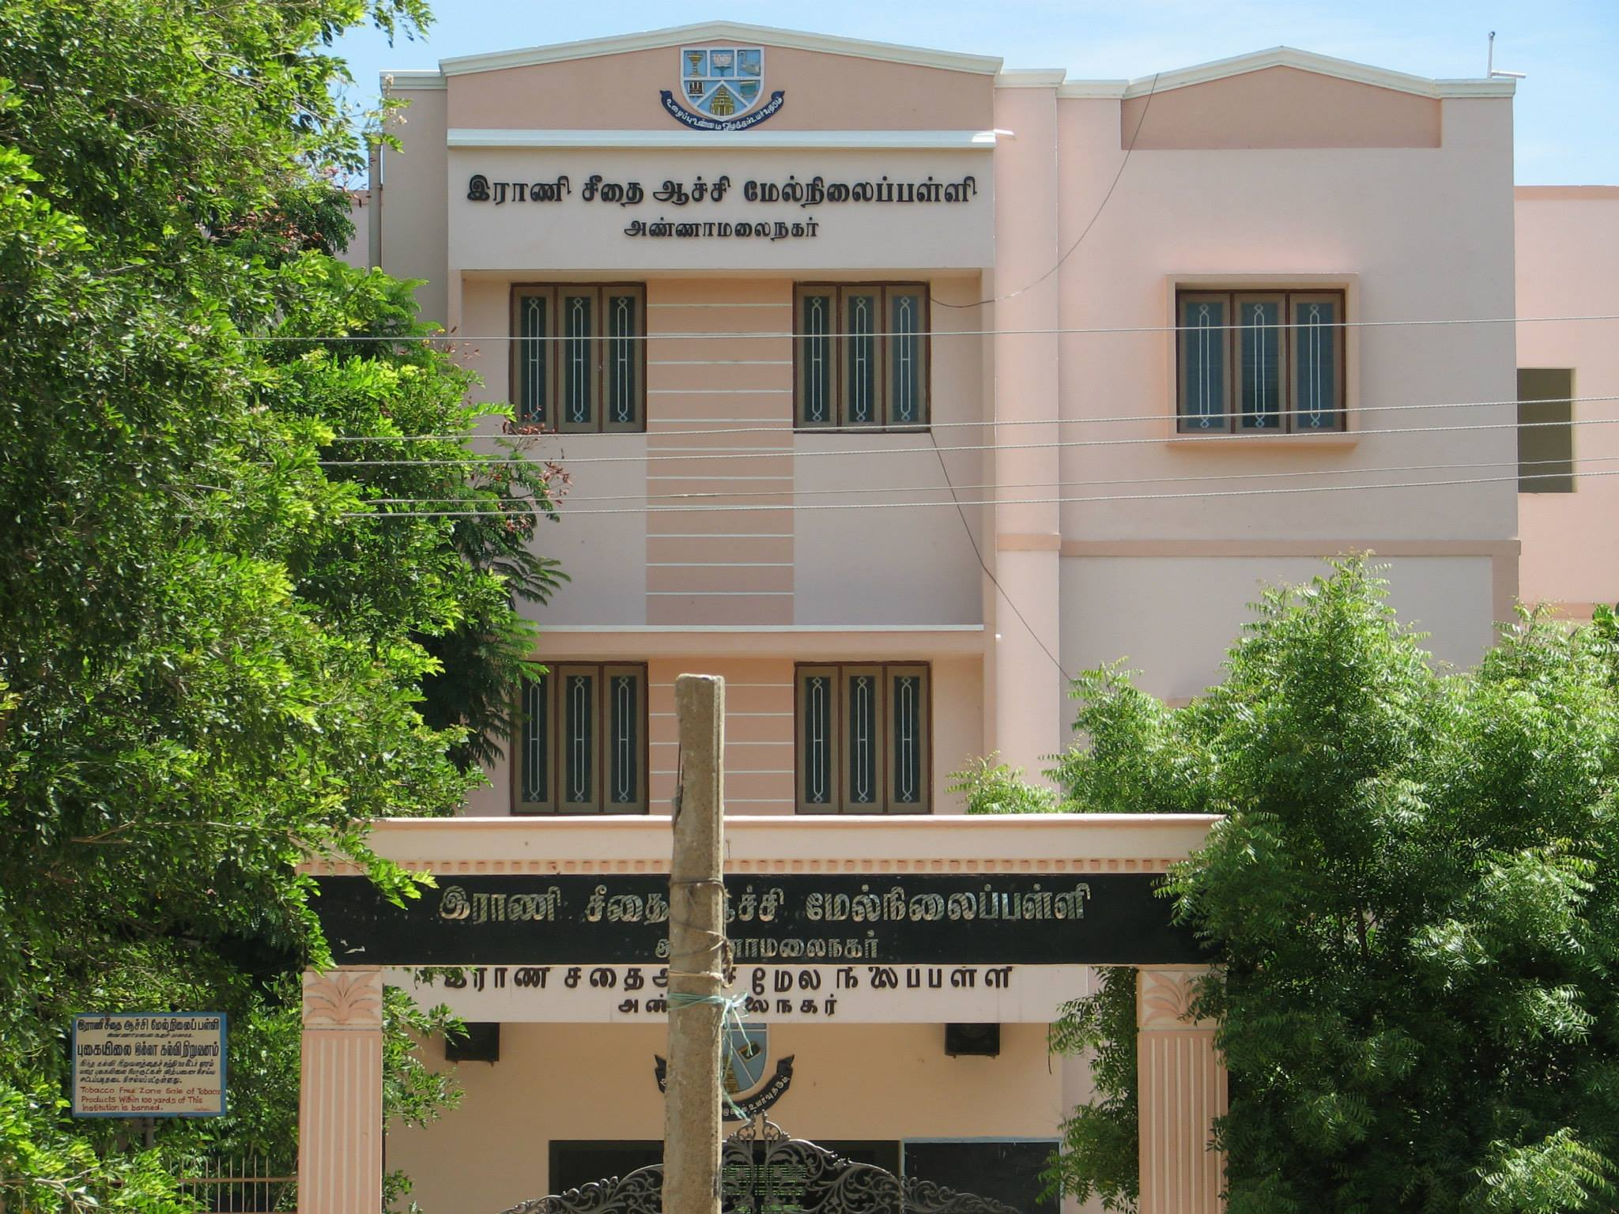
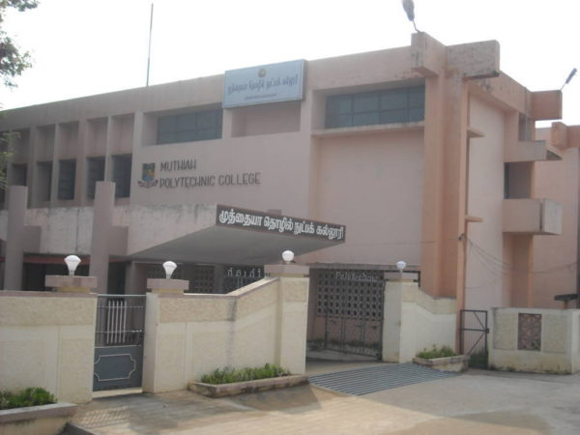


About me

Slide 4

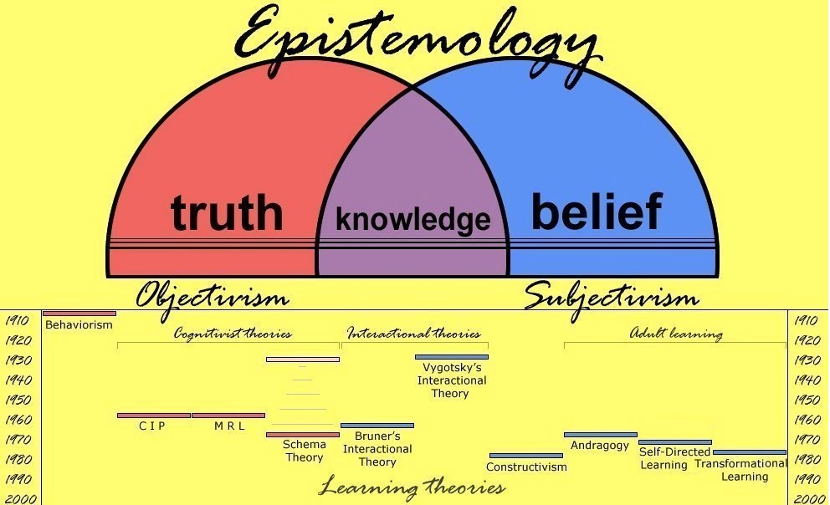

Philosophy of Pattern Matching

Slide 5


Silicon Wafer Inspection

Slide 6
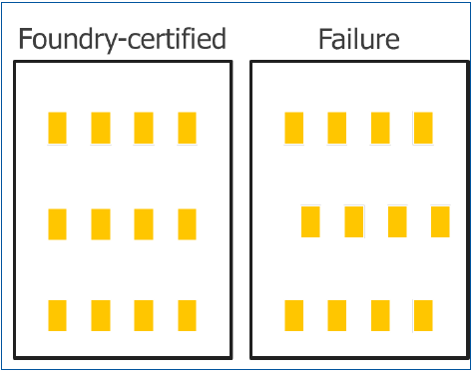
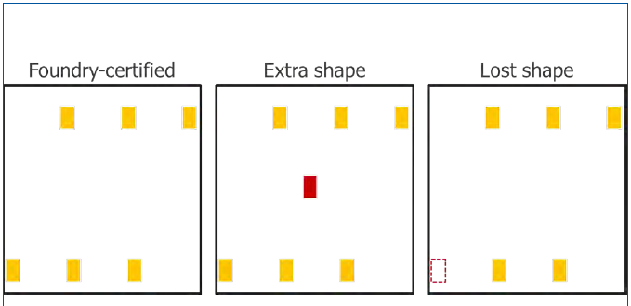
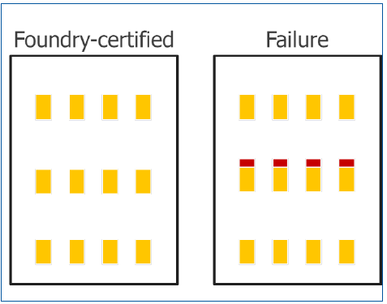
The problem
Shape shifting
Extra / Fewer Shapes
Shapes change

Slide 7
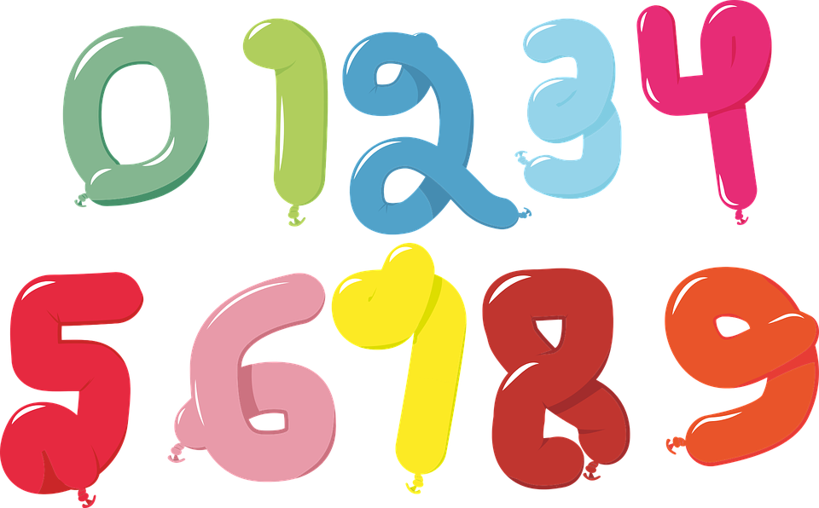
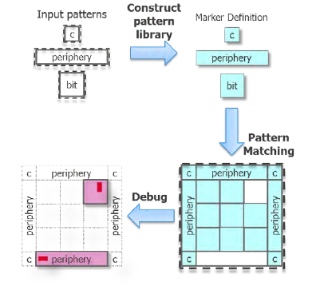
The Solution

Slide 8

The role of pattern matching

Slide 9
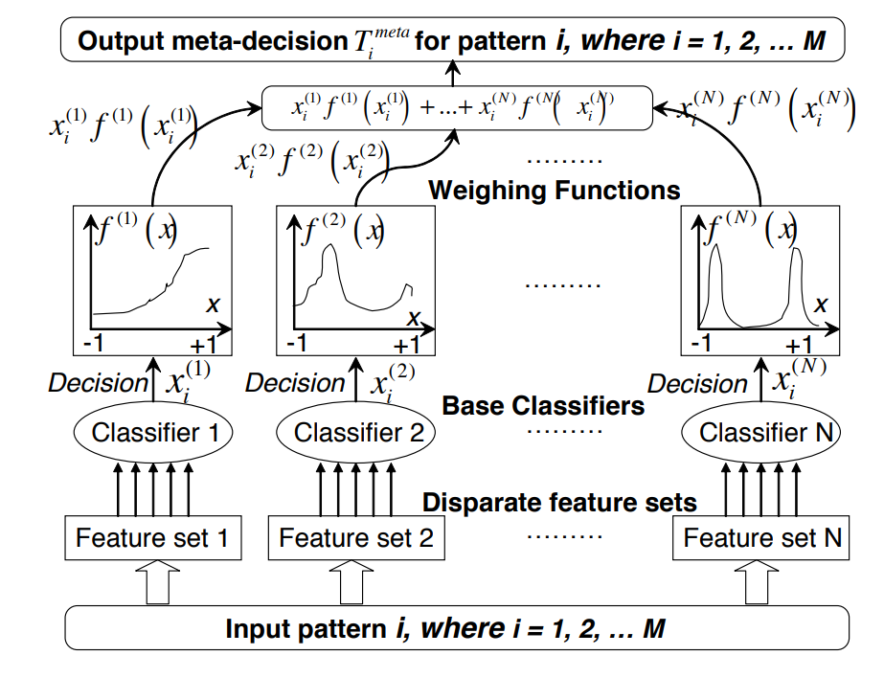
Some details …

Slide 10
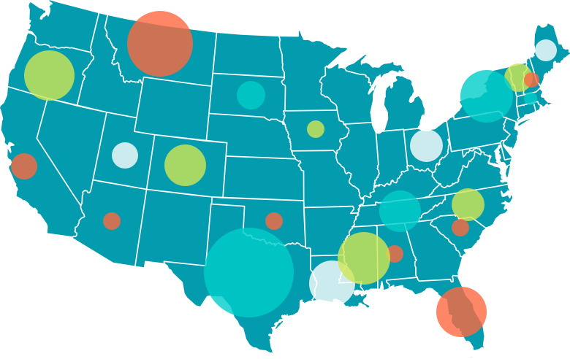
Pattern Matching in Healthcare
The Problem
The Healthcare data in US

Slide 11
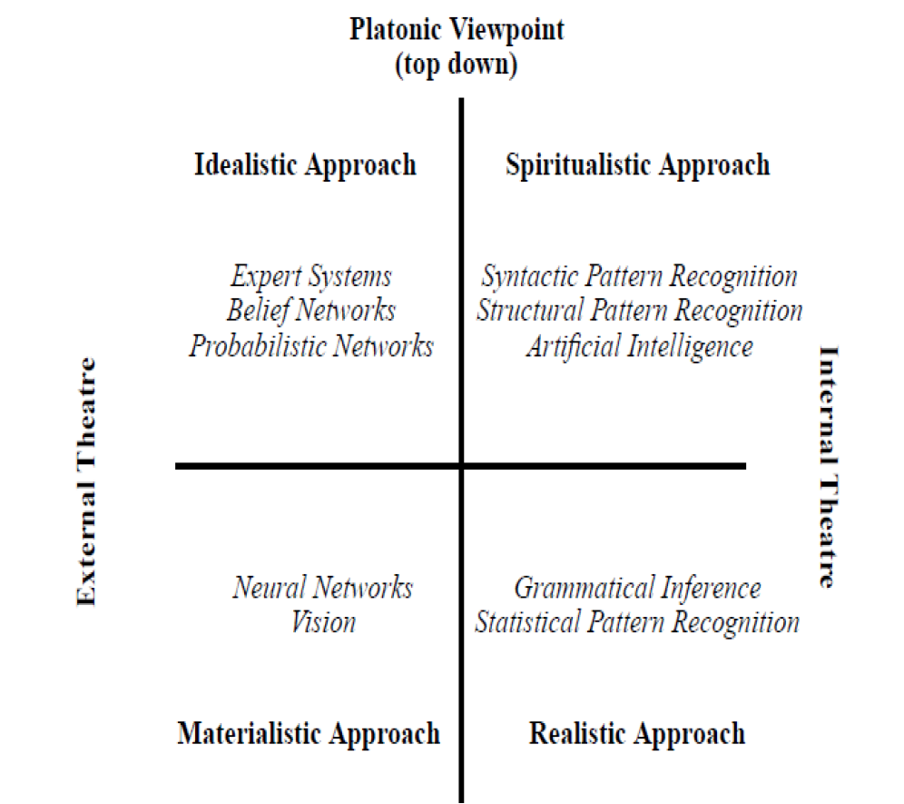

Slide 12
Pattern Matching in Healthcare
Text matching for providers
Search for AUDREY WAROLIN in (https://npiregistry.cms.hhs.gov/)
Search the same with Algolia (https://www.algolia.com/apps/JR8QW57XU4/explorer/browse/NPPES_Data)

Slide 13
Discuss
Typo tolerance
Synonyms
Query Rules

Slide 14



Questions
http://soundararajan.in
soundararajan@outlook.com
twitter.com/soundararajan

